Slide 1
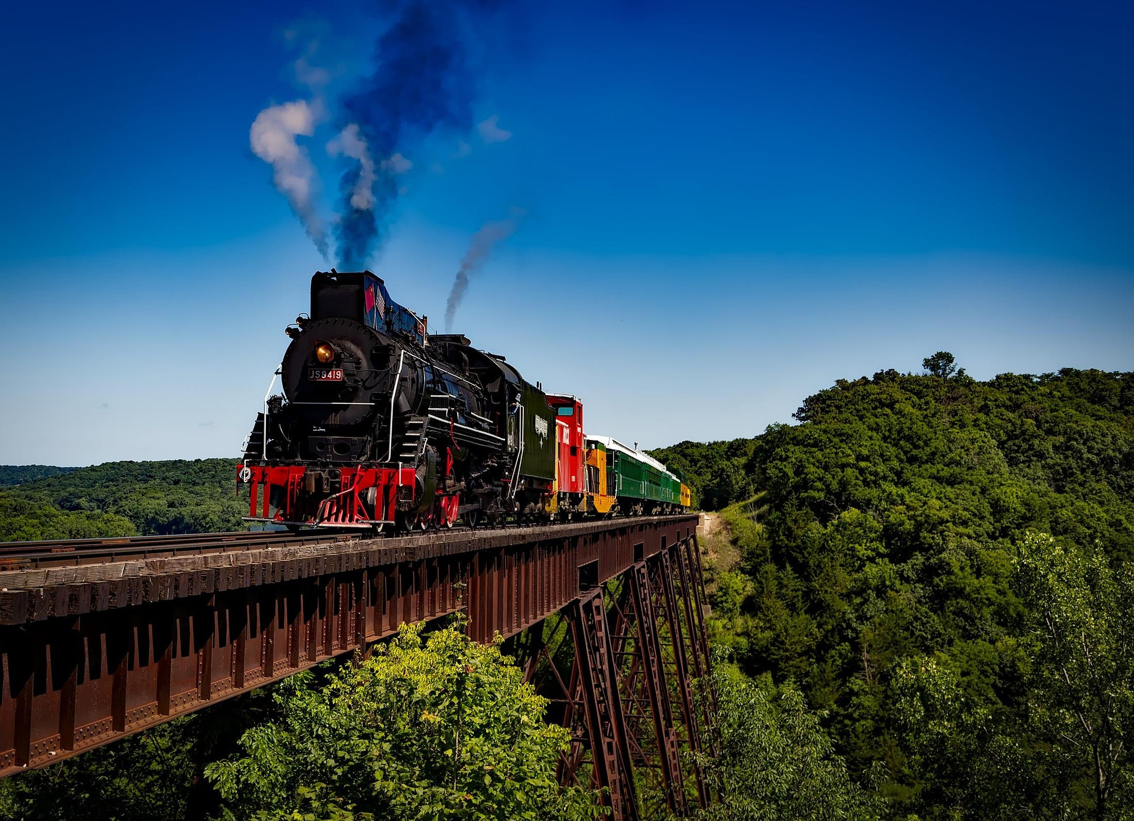


Group No : 25-26J-134
AI Powered Train Safety System
with Real-Time Crowd and Obstacle Detection
SLIIT
Faculty of Computing

Slide 2
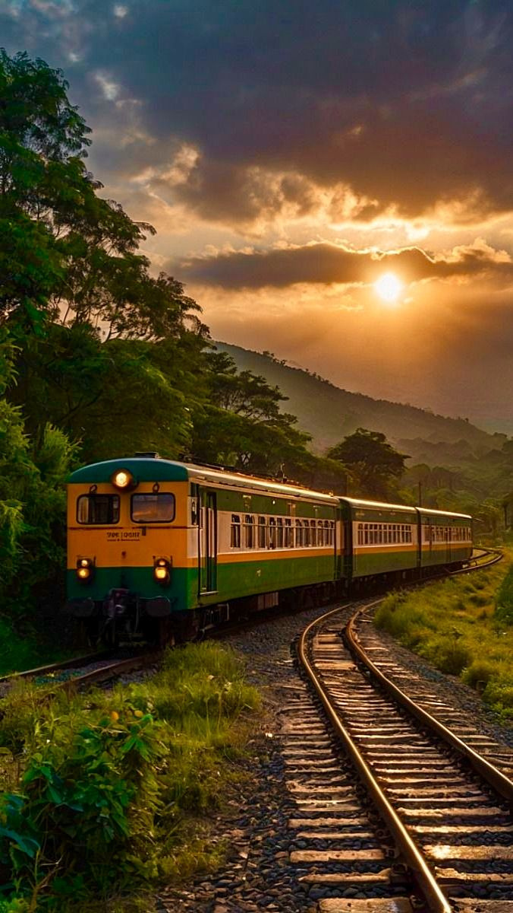

Contents
Problem & Motivation
Solution Overview
System Architecture & Integration
Design Excellence (Components)
Commercialization & Market Potential
One Minute Solution Video
Demo Plan

Slide 3
Problem Statement & Motivation
Context
Railway transportation systems often face safety and operational efficiency challenges, especially in high-density passenger environments and train collision.
Stakeholders
Primary Users :
Train Drivers ,Railway Operators
Secondary Users :
Passengers ,Station Management Staff
Railway Authorities ,Transport Ministries
Observed Issues
Train overcrowding causes unsafe boarding
Obstacles on railway tracks cause accidents and delays
Driver fatigue and drowsiness often go undetected
Why It Matters
Passenger safety risks
Train delays and operational inefficiency
Increased accident probability
Economic losses

Slide 4
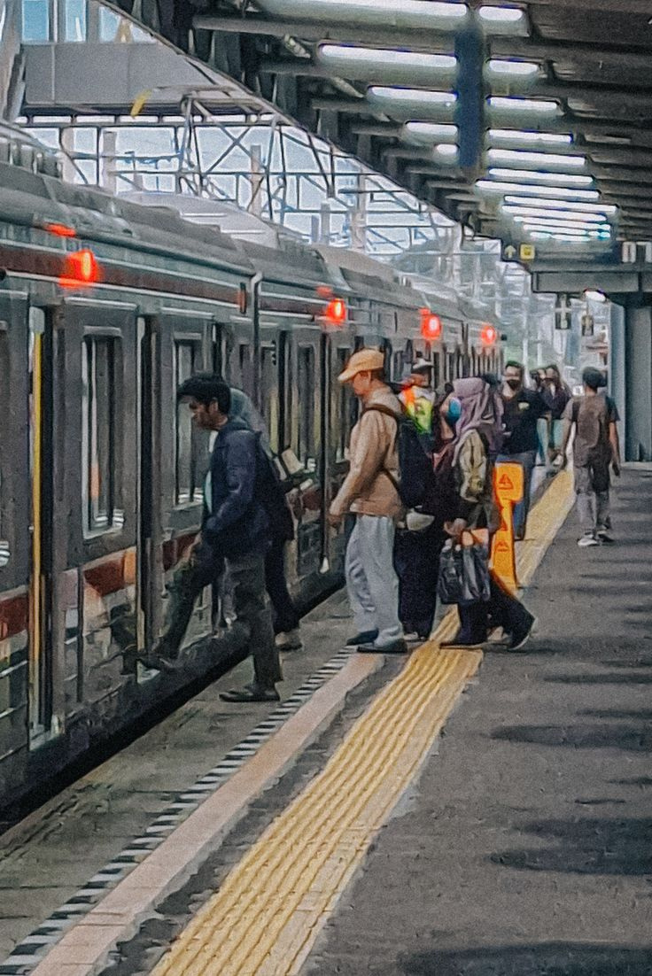
Solution Overview
Solution Summary
An AI-powered integrated railway safety system that detects crowd density, track obstacles, and driver fatigue in real time to improve railway safety and operational efficiency.
Key Features
Crowd Density Detection in train compartments
Platform Compartment Alignment Optimization
Real-Time Obstacle Detection & Alerting
Intelligent Driver Fatigue Monitoring
Non Functional Focus
Real-time performance
Reliability
Privacy preserving (no identity storage)
Hardware compatibility with existing infrastructure
Current Completion Status
90–95% completed prototype

Slide 5
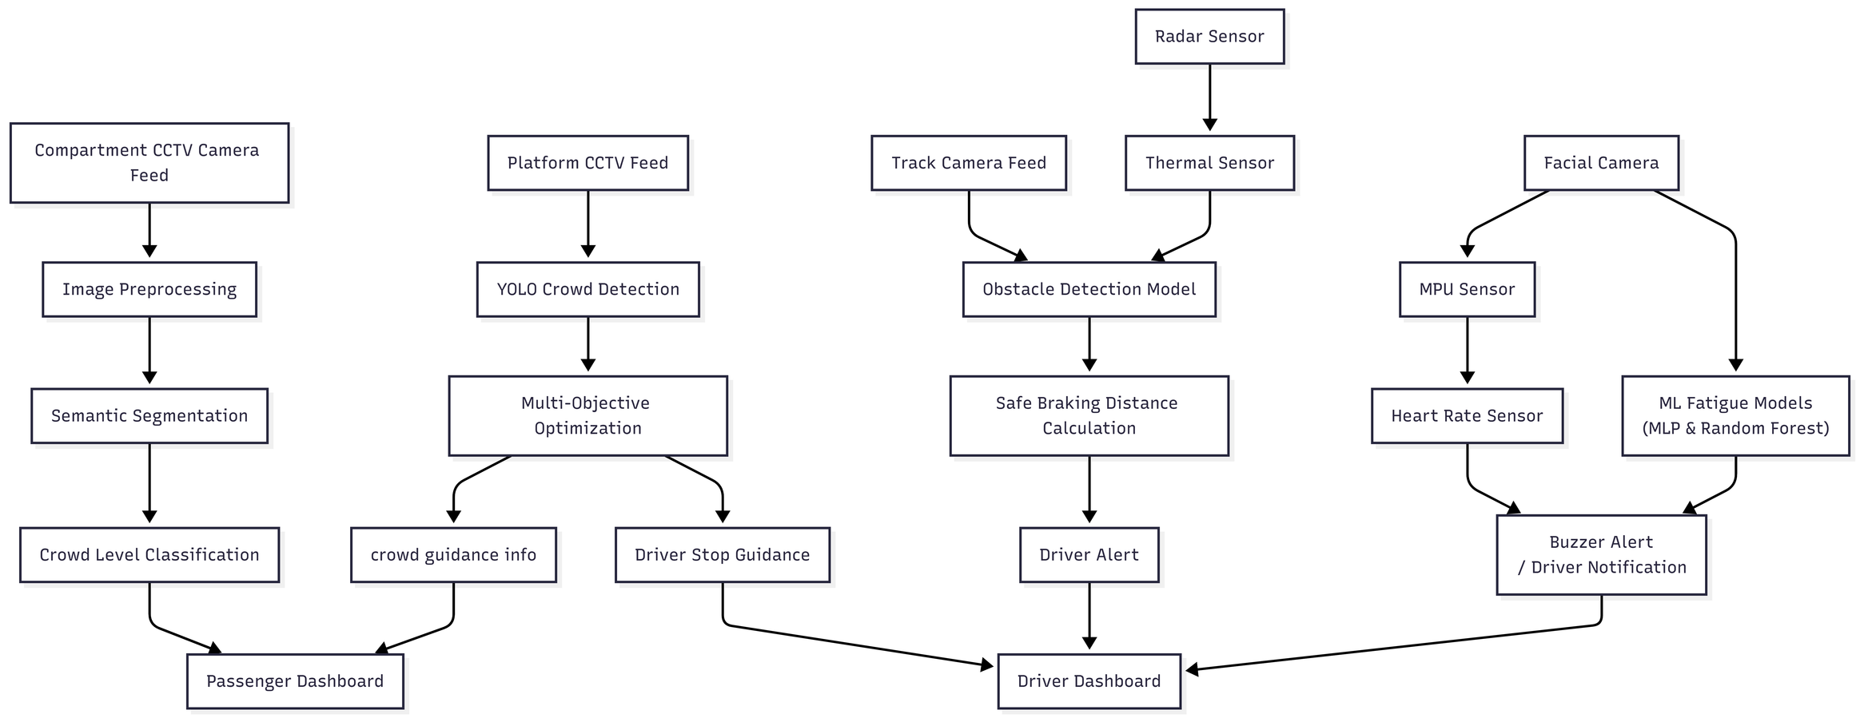
System Architecture Diagram

Slide 6

System Architecture & Integration
System Component | Team Member
Crowd Density Detection Module | IT22283412 - Udaya Sri A L S
Platform Alignment Optimization Module | IT22250988 - Bandara I K
Obstacle Detection & Alerting Module | IT22291578 - Prarthana L D R
Intelligent Driver Support System | IT22597342 - Jayasinghe J M H C
Integration Points
Python ML models
Sensor data via Arduino serial communication
REST APIs for data exchange
JSON data format
Deployment Setup
Edge processing
Local server
Sensor integration

Slide 7
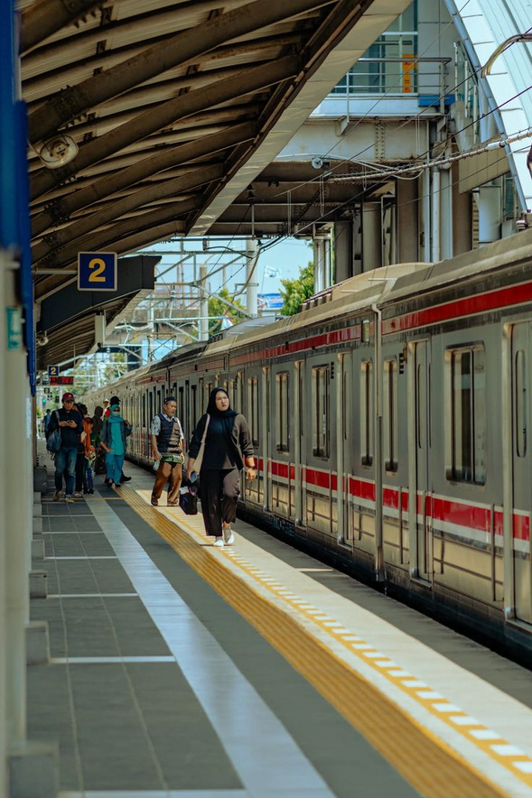
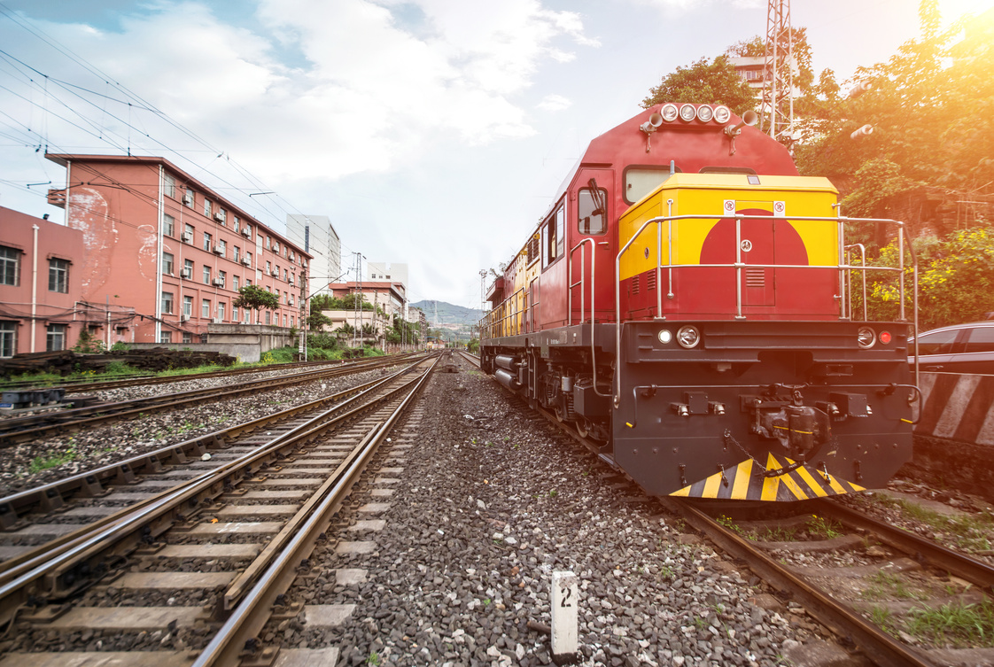
Commercialization
Target Users / Market
Railway authorities and transport ministries
Station operators and control centers
Urban metro and suburban railway systems
Value Proposition
Integrated AI system combining crowd monitoring, obstacle detection, and driver fatigue detection
Improves passenger safety and operational efficiency
Works with existing CCTV infrastructure, reducing deployment cost
Cost and Feasibility
Uses low-cost cameras and sensors with AI software integration
Deployable as an add-on system without major railway infrastructure changes
Estimated low to moderate deployment cost per station/train

Slide 8
DEMO PLAN
Step 1 : Compartment Crowd density detection module live demo + Performance Improvement
Step 2 : Platform Compartment Alignment Optimization module live demo + Performance Improvement
Step 3 : Obstacle Detection and Alerting module live demo + Performance Improvement
Step 4 : Intelligent Driver Support System live demo + Performance Improvement

Slide 9
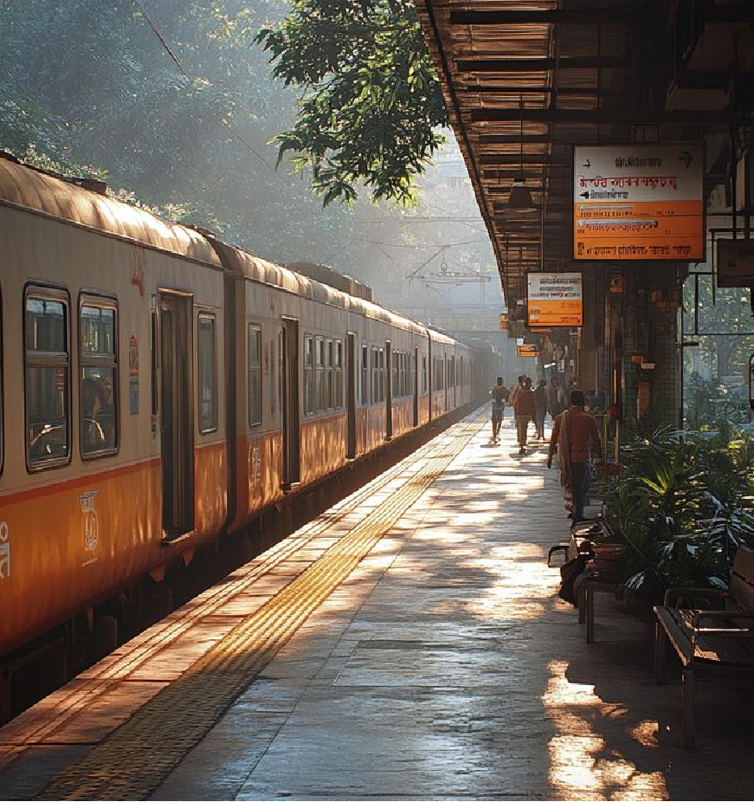
THANK YOU !!

